Slide 1
Operating Cisco Routers
Liu Cui

Slide 2
Installing Enterprise Routers
A typical enterprise network has a few centralized sites as well as lots of smaller remote sites.
To support devices at each site (computers, IP phones, printers, etc), the network includes at least
One LAN switch at each site
One router that connect the LAN switch to WAN link
The WAN link provides connectivity from each remote site, back to the central site.

Slide 3
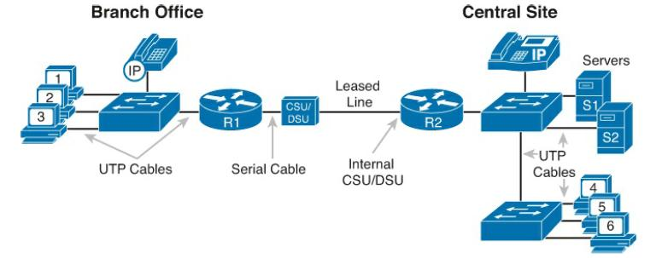
Installing Enterprise Routers
Channel service unit/data service unit (CSU/DSU)
connect a data terminal equipment (DTE), such as a router, to a digital circuit, such as a Digital Signal 1 (T1) line. The CSU/DSU implements two different functions. The channel service unit (CSU) is responsible for the connection to the telecommunication network, while the data service unit (DSU) is responsible for managing the interface with the DTE.

Slide 4
Physical Installation of Enterprise Routers
Step 1. Connect any LAN cables to the LAN ports
Step 2. If using an external CSU/DSU, connect the router’s serial interface to the CSU/DSU and the CSU/DSU to the line from the telco.
Step 3. If using an internal CSU/DSU, connect the router’s serial interface to the line from the telco.
Step 4. Connect the router’s console port to a PC (using a rollover cable), as needed, to configure the router.
Step 5. Connect a power cable from a power outlet to the power port on the router.
Step 6. Power on the router.

Slide 5
Installing Internet Access Routers
Routers play a key role in SOHO networks, connecting the LAN-attached end-user devices to a high-speed Internet access service.
Most SOHO products go by the name router, but happen to include many networking functions in a single device.
Because of that, when learning about networking, it can be difficult to appreciate the different functions the device performs.

Slide 6
Installing Internet Access Routers
This figure has many similarities to the previous one.
The main differences between the SOHO connection and the enterprise branch relate to the connection into the Internet.
An Internet connection that uses CATV (cable TV) or digital subscriber line (DSL) needs a device that converts between the Layer 1 and 2 standards used on the CATV cable or DSL line and the Ethernet used by the router. These devices, commonly called modems, convert between CATV/DSL layer 1 and layer 2 standards to Ethernet, and vice versa.

Slide 7
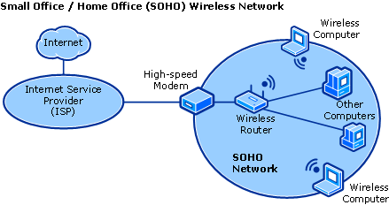
Installing Internet Access Routers

Slide 8
Enabling IPv4 Support on Cisco Router Interfaces
To make routers work –that is, to route IPv4 packets –the interfaces must be configured.
Accessing the Router command-line interface (CLI) works much like a switch. They share many of the same CLI navigation features, and many of the same configuration commands for management features:
User and Enable (privileged) mode
Entering and exiting configuration mode, using the configure terminal, end, and exit commands and the Ctrl+Z key sequence
Configuration of console, Telnet (vty), and enable secret passwords

Slide 9
Enabling IPv4 Support on Cisco Router Interfaces
Configuration of Secure Shell (SSH) encryption keys and username/password login credentials
Configuration of hostname and interface description
Configuration of Ethernet interfaces that can negotiate speed using the speed and duplex commands
Configuration of an interface to be administratively disabled (shutdown) and administratively enabled (no shutdown)
Navigation through different configuration model contexts using commands like line console 0 and interface type number
CLI help, command editing, and command recall features
The meaning and use of the startup-config (in NVRAM), running-config (in RAM), and external servers (like TFTP), along with how to use the copy command to copy the configuration files and IOS images

Slide 10
Enabling IPv4 Support on Cisco Router Interfaces
Difference between router CLI and switch CLI
The configuration of IP addresses differs in some ways, with switches using a VLAN interface and routers using an IP address configured on each working interface
Many Cisco router models have an auxiliary (Aux) port, intended to be connected to an external modem and phone line to allow remote users to dial in to the router, and access the CLI, by making a phone call. Cisco switches do not have auxiliary ports.
Router IOS defaults to disallow both Telnet and SSH into the router because of the default setting of transport input none in vty configuration mode. To enable Telnet, use transport input telnet command. To enable SSH, use transport input ssh command.

Slide 11
Router interfaces
One minor difference between Cisco switches and routers is that routers support a much wider variety of interfaces, including serial interfaces, cable TV, DSL, 3G/4G wireless, etc.
Two of the most common commands to display the interfaces, and their status, are the
show ip interface brief: list one line per interface, with basic information, including the interface IP address and interface status.
show interfaces commands: lists the interfaces with a large amount of information per interface.

Slide 12
Router Interface IP Addresses
Cisco enterprise routers require at least some configuration beyond the default configuration before they will do their primary job: routing IP packets. Followings are the facts about the router:
Most Cisco router interfaces default to a disabled (shutdown) state and should be enabled with the no shutdown interface subcommand.
Cisco routers do not route IP packets in or out an interface until an IP address and mask have been configured; by default, no interfaces have an IP address and mask.
Cisco routers attempt to route IP packets for any interfaces that are in an up/up state and that have an IP address/mask assigned.
To configure the address and mask: ip address address mask

Slide 13
Bandwidth and Clock Rate on Serial Interfaces
WAN serial links can run at a wide variety of speeds. To deal with the wide range of speeds, routers physically slave themselves to the speed as dictated by the CSU/DSU through a process called clocking. As a result, routers can use serial links without the need for additional configuration or autonegotiation to sense the serial link’s speed. The CSU/DSU knows the speed, the CSU/DSU sends clock pulses over the cable to the router, and the router reacts to the clocking signal.
Some people confuse the router bandwidth command with the clock rate command. The clock rate command sets the actual Layer 1 speed used on the link. The bandwidth of the interface is the documented speed of the interface, which does not have to match the actual Layer 1 speed used on the interface.

Slide 14
Router Auxiliary Port
Both routers and switches have a console port to allow administrative access, but most Cisco routers have an extra physical port called an auxiliary (Aux) port. The Aux port typically serves as a means to make a phone call to connect into the router to issue commands from the CLI.

